Slide 1


DROPLET NUCLEATION IN TURBULENT STEAM JETS
A. Gallegati, F. Battista, P. Gualtieri, C.M. Casciola
Department of Mechanical and Aerospace Engineering

Slide 2

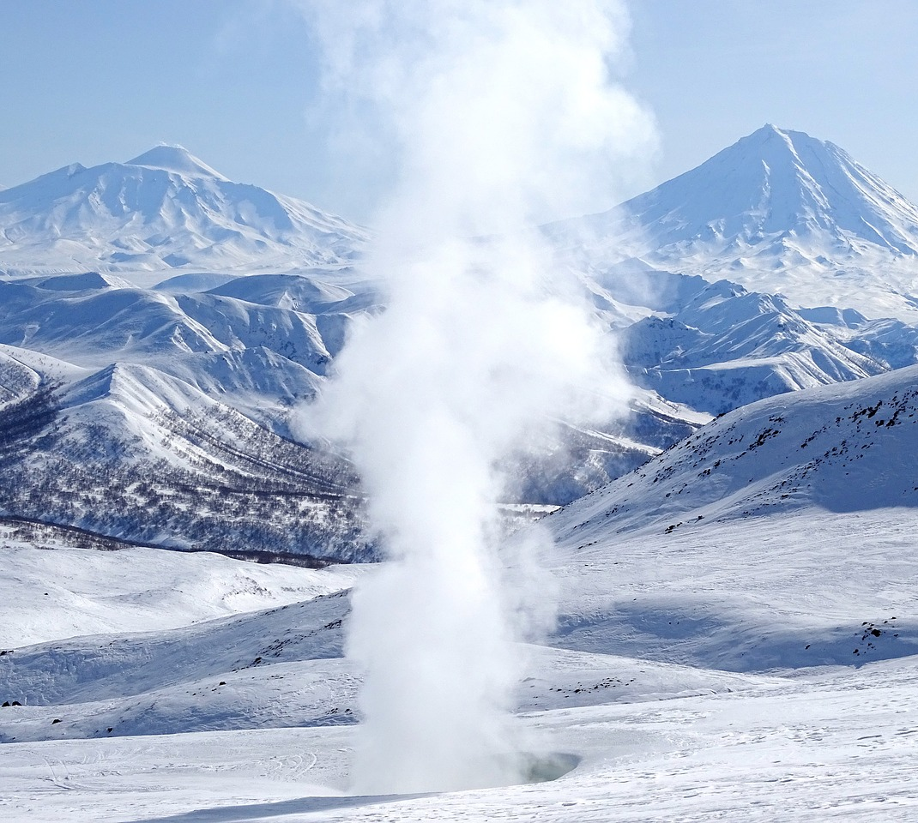
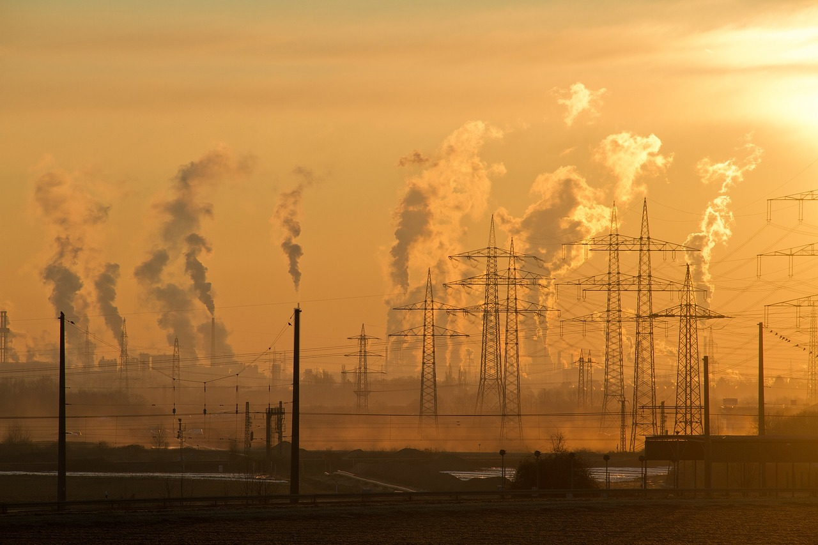
Steam jets & Droplets Nucleation
Droplets Nucleation
homo/heterogeneous
homo/heteromolecular
Turbulent flows

Slide 3
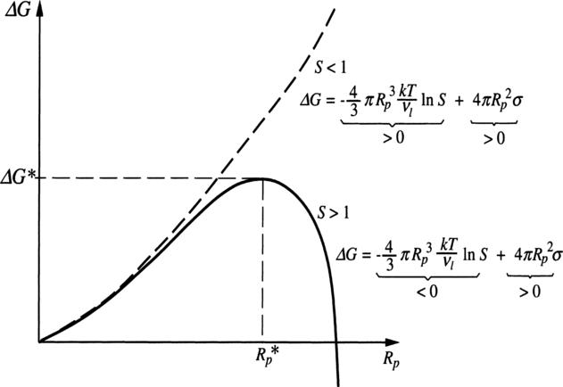
Molecules cluster Free Energy

Slide 4
Classical Nucleation Theory rate

Slide 5
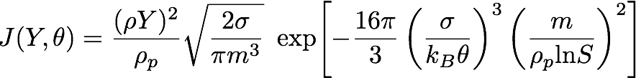
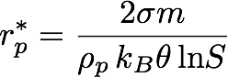
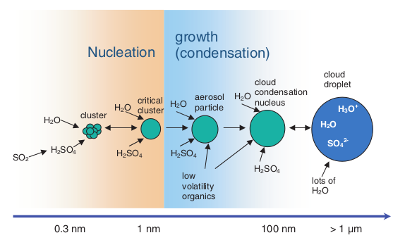
Homogeneous droplets nucleation
CNT homogeneous rate [ Becker, R. & Döring, W. 1935, Ann. Phys. ]
Droplet nucleation - Poisson process ( local thermodynamical equilibrium hp. )

Slide 6
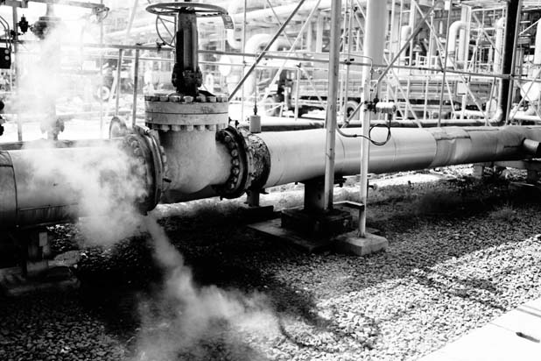
Dibutyl phthalate - DBP
stable organic compound with low toxicity
very low vapour pressure at ambient temperature
USA released 70000 lb in the atmosphere in 1994 ( 38 % as fugitive emissions - EPA)
Experiments [ Lesniewski, T.K. & Friedlander, S.K. 1998, Proc. Royal Soc. A ]
RANS [ Di Veroli, G.Y. & Rigopoulos, S. 2011, Phys. Fluids ]
LES [ Pesmazoglou, I., et al. 2014, Chem. Eng. Sci. ]
DNS [ Fager, A. J. et al. 2012, Phys. Fluids ] – “ a posteriori nucleation ”
What next ? Complete interphase coupling ( mass, momentum and energy )

Slide 7

Droplets nucleation in a turbulent steam jet

Slide 8
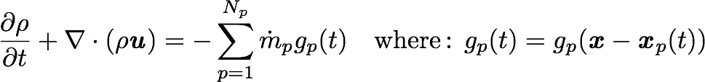
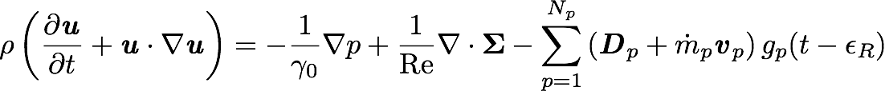
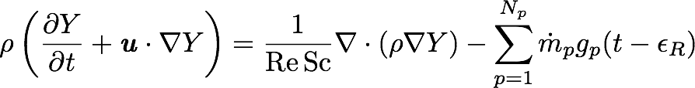
Navier Stokes complete system
[ Okong’o, N.A. & Bellan, J. 2004, J. Fluid Mech. ] low-Mach formulation
droplets back-reaction regularised according to [ Gualtieri, P. et al. 2015, J. Fluid Mech. ]

Slide 9
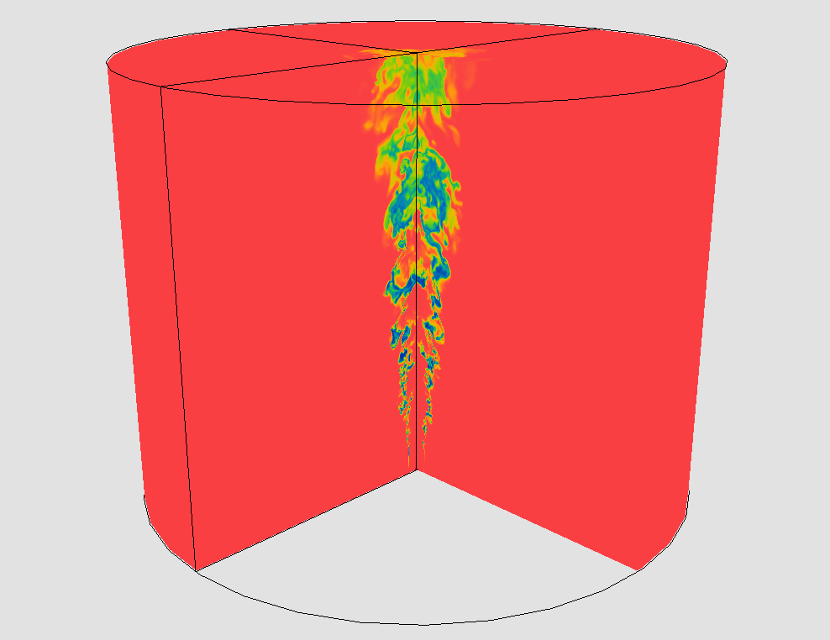
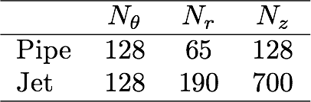
The three-dimensional domain

Slide 10
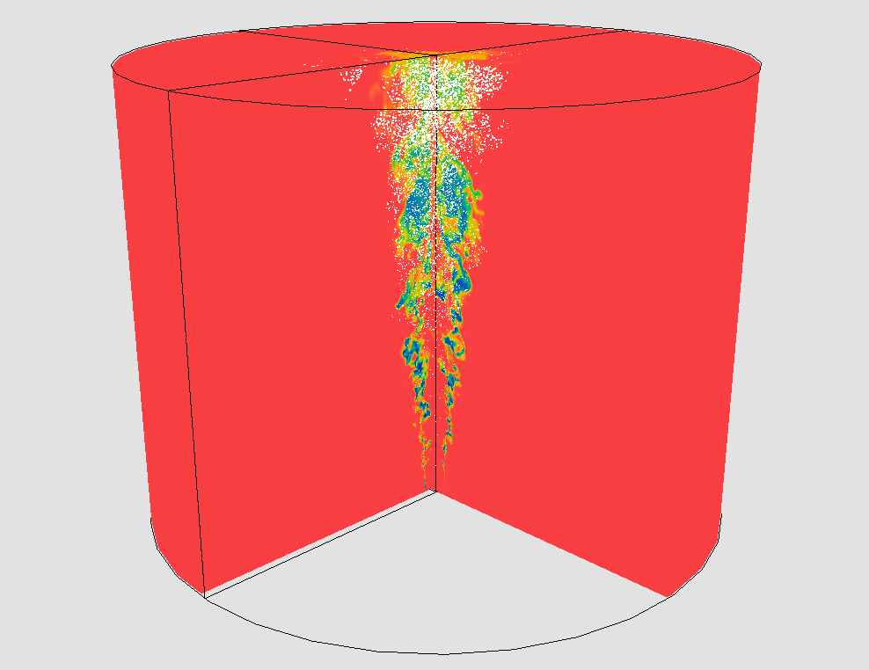
Slice of the three-dimensional domain

Slide 11

Droplets back-reaction
Nucleation rate
( carrier flow )
Vapour sink ( droplets feedback )

Slide 12
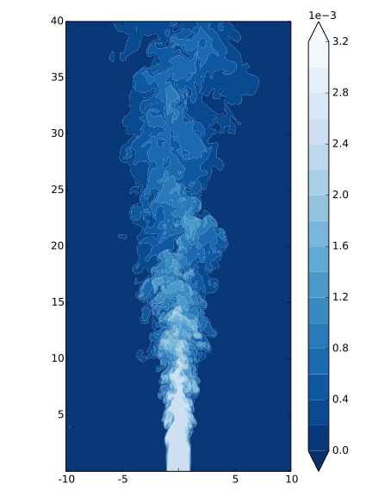
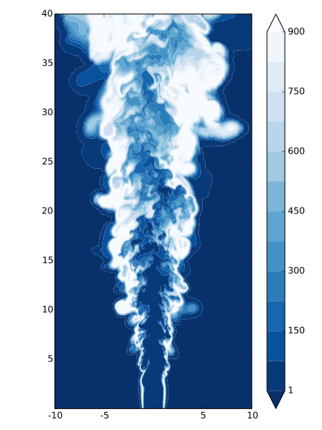
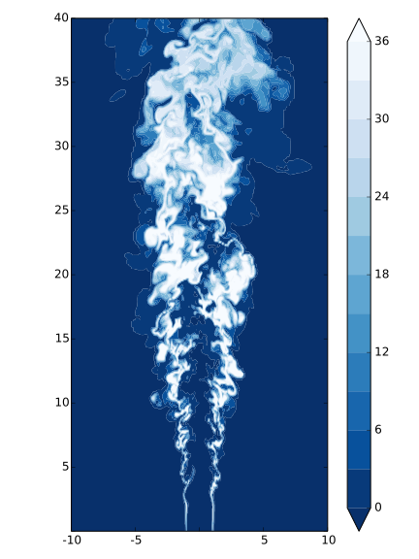
Turbulent fluctuations & Nucleation rate
Vapour mass fraction
Saturation ratio
Nucleation rate
Nucleation rate is highly intermittent due to turbulent mixing

Slide 13
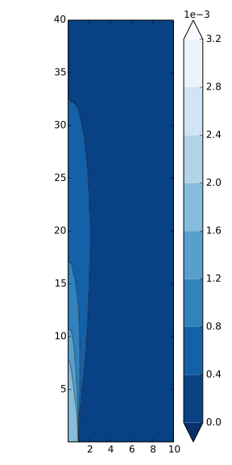
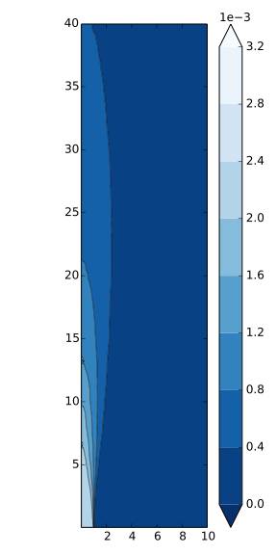

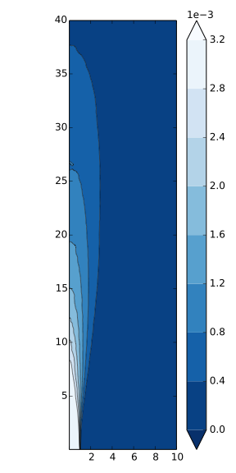
Vapour mass fraction injected - mean fields
Y = 0.0018
Y = 0.0021
Y = 0.0025
Y = 0.0032
Vapour mass fraction as in Lesniewski & Friedlander 1998, Proc. Royal Soc. A

Slide 14
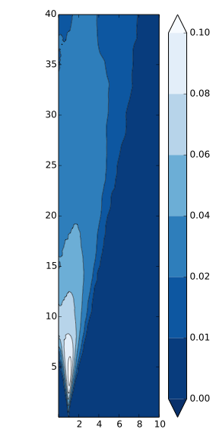
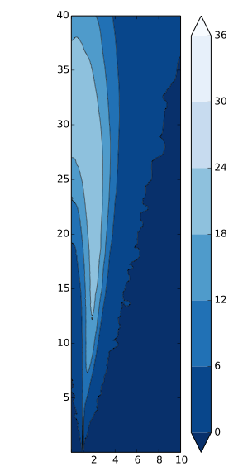
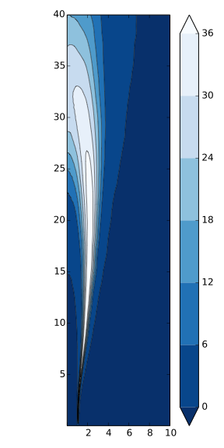
Turbulent fluctuations & mean Nucleation rate
Temperature rms
mean Nucleation rate
“ RANS-like ” Nucleation rate
Nucleation rate highly non linear function of local thermodynamic state
Crucial effect of turbulent fluctuation in determining mean Nucleation process

Slide 15
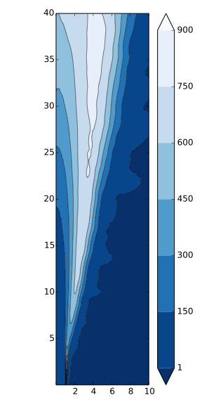
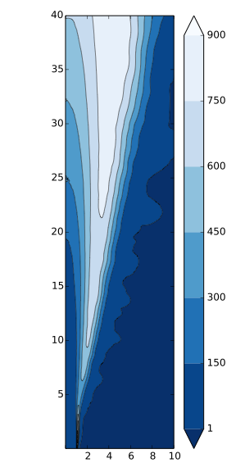
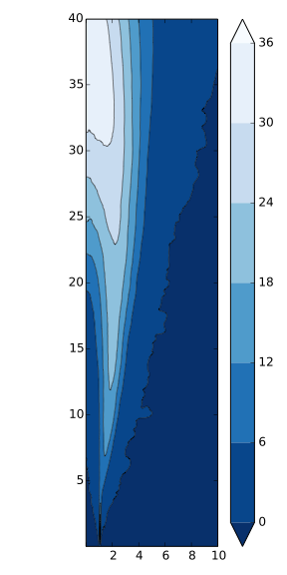
Two-way coupling effects on Nucleation rate
two-way
one-way
two-way
one-way
Saturation ratio
Nucleation rate
Particles feedback affects the Saturation ratio & the consequent Nucleation rate

Slide 16
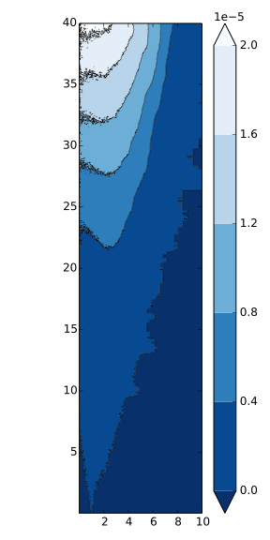
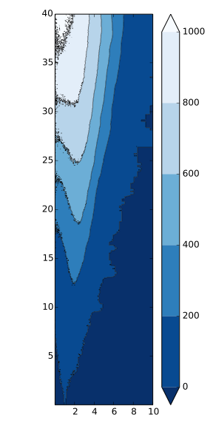
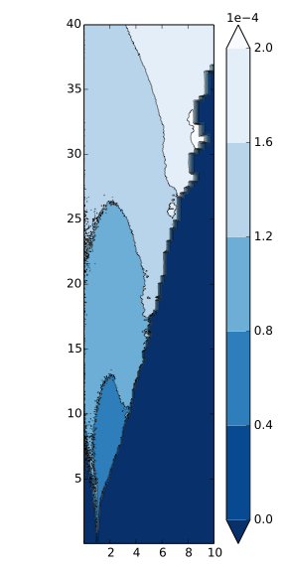
Mass load - droplets mean size & concentration
mass loading
droplet conc.
droplet radius

Slide 17
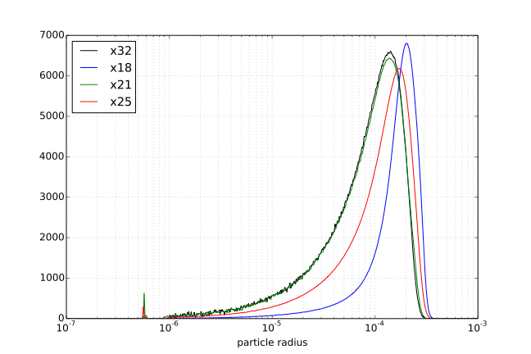
Droplets size distribution

Slide 18
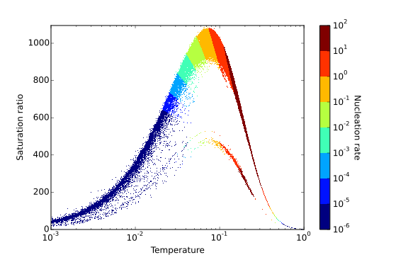
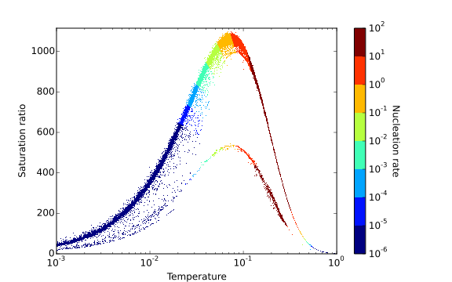
Conclusions & next steps
Crucial for Nucleation process
Relevance of turbulent fluctuations
Relevance two-way coupling
looking for correlations
simulating longer domain
evaluating the effects of :
Nucleation
Condensation
Mixing
enhancing mass transfer model

Slide 19
Conclusions & next steps
Crucial for Nucleation process
Relevance of turbulent fluctuations
Relevance two-way coupling
looking for correlations
simulating longer domain
evaluating the effects of :
Nucleation
Condensation
Mixing
enhancing mass transfer model

Slide 20
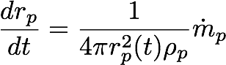
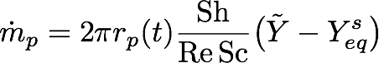
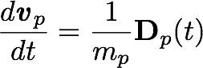
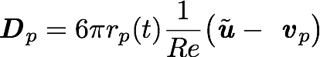
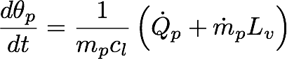
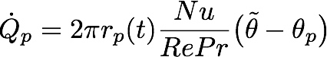
Droplets dynamics & Source terms

Slide 21
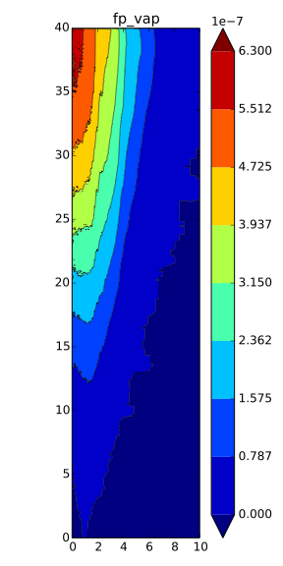
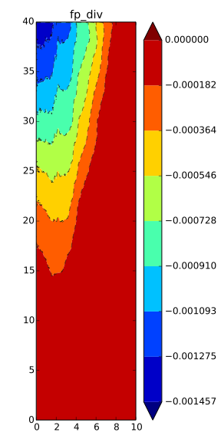
Droplets back-reaction

Slide 22
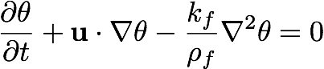
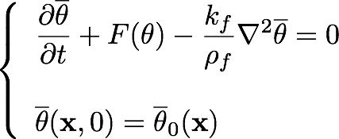
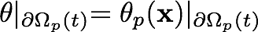
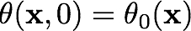
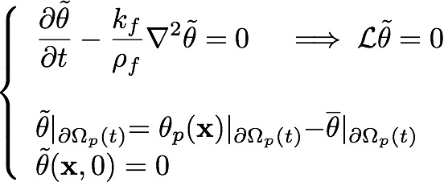
ERPP method - a simplified example
Temperature field decomposition – background & disturbance

Slide 23
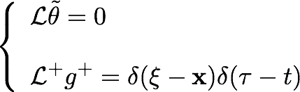
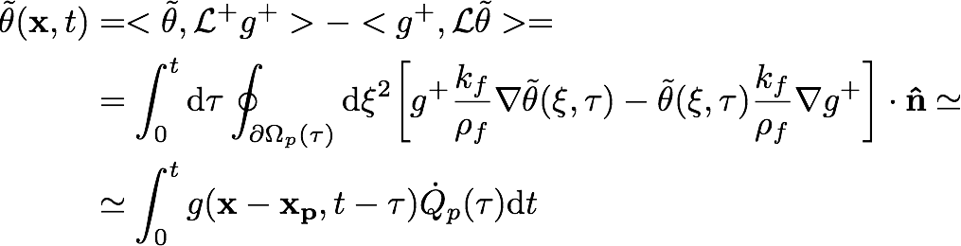
Green’s theorem – Boundary integral representation
Adjoint operator [Stakgold, 1987]:
Reciprocity Thm. [Lanczos, 1961]:

